Slide 1
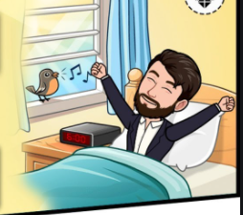
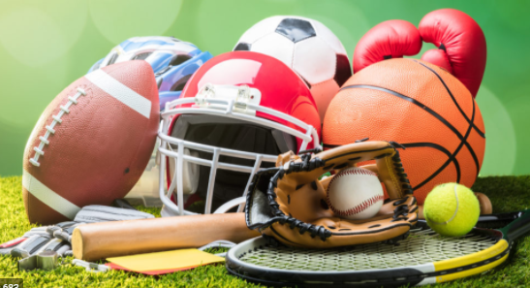
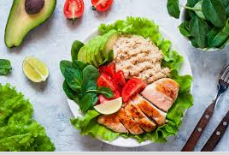
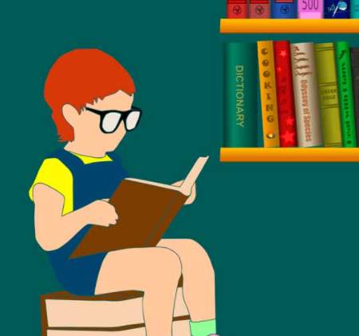
My ideal self
My ideal self usually wakes up at 5 am
My ideal self frequently practices a sport
My ideal usually self likes to read
My ideal self rarely eats healthy food

Slide 2
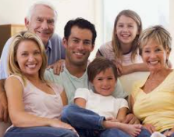
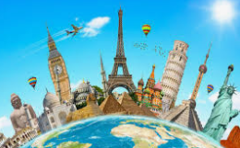
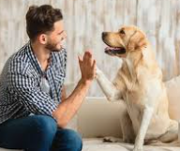
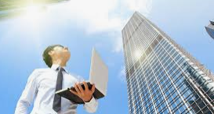
My ideal self
My ideal self always spends time with his family
My ideal self frequently travels around the world
My ideal self usually has a lot of pets
My ideal self usually Works in a big company

Slide 3
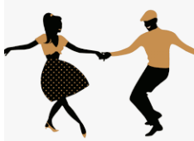
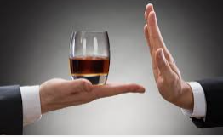
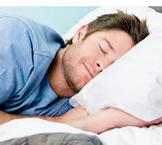
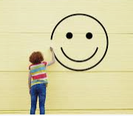
My ideal self
My ideal self seldom knows to dance salsa
My ideal self hardly ever drinks alcohol
My ideal self always goes to bed early
My ideal self always has a happy life

